Slide 1
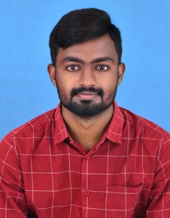





EXPERIENCE
Analyst / Software Engineer
(November 2021 - Present)
CAPGEMINI - Mumbai
EDUCATION
B.Tech.
(2017-2021)
MAHATMA GANDHI INSTITUTE OF TECHNOLOGY,HYDERABAD
Specialization- Mechanical Engineering
Manvith Reddy Yalla
Analyst / Software Engineer
Online shopping Application ( Project)
Designed and Developed the frontend of the website using HTML, CSS and Java script.
Good exposure to separate designing tools like Angular and Bootstrap along with styling using CSS.
Performed backend database operations using PostgreSQL with DevOps, JPA with Hibernate 3.0, Spring 5.0 and Core Java 8.
In this application search is limited to string or by number. Cannot do search by photo and finger print.
This application will help Customer to buy the products and view order details.
SUMMARY
I am a hardworking and ambitious individual with a great passion for the IT industry. I have strong technical skills as well as excellent interpersonal skills. I am eager to be challenged in order to grow and further improve my IT skills. I’ve done several certifications to improve my technical knowledge and frontend designing skills. My greatest passion is in life is using my technical know-how to benefit other people and organisations.
CERTIFICATIONS
Course | Platform
Programming for Everybody (getting started with python) | Coursera
Channel Management and Retailing | Coursera
KEY SKILLS
Core Java
Basics of python
HTML, CSS
MS Excel
Power Point Presentation
Communication Skills
8019353937
YALLA.MANVITH-REDDDY@CAPGEMINI.COM

